Slide 1
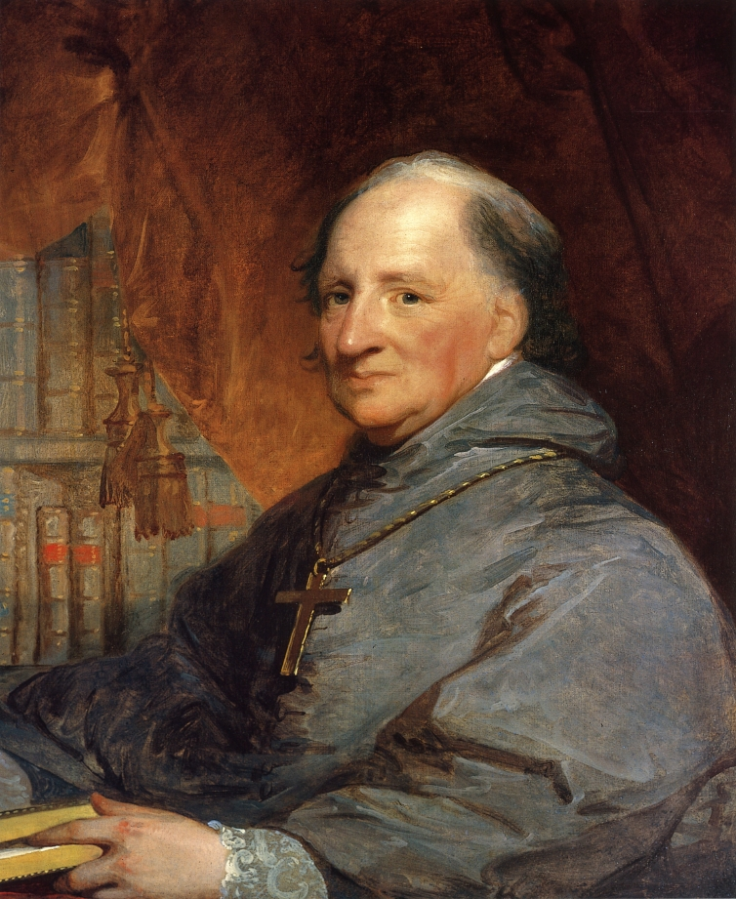
Classical Allusions and Magisterial Religion in Early America (1789-1840)

Slide 2
Hypotheses
H₁: Protestants use more classical allusions than Catholics H₂: Protestants will use Classical allusions more pedagogically

Slide 3
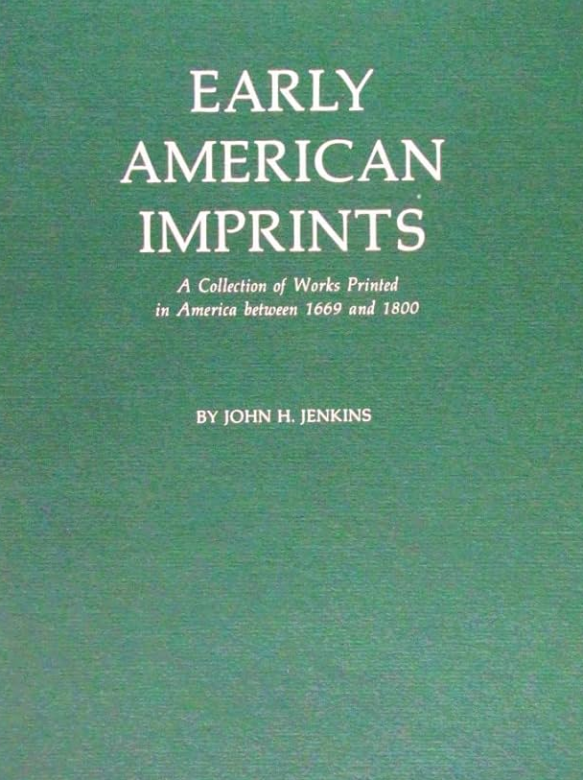


Datasets
Protestant Sermons (~1790-1840) n=487
Catholic Magisterial Documents (~1790-1840) n=40

Slide 4
Frequency of Classical Allusions
 | Protestant | Catholic
# of Allusions | 396 | 47
# of Allusions/Text | 0.815 | 1.175

Slide 5
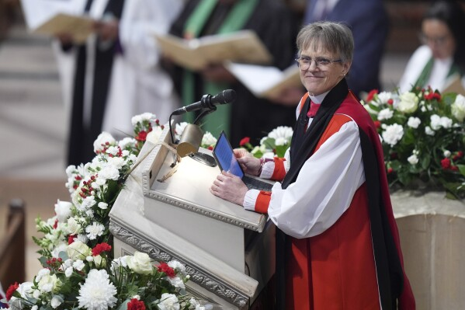
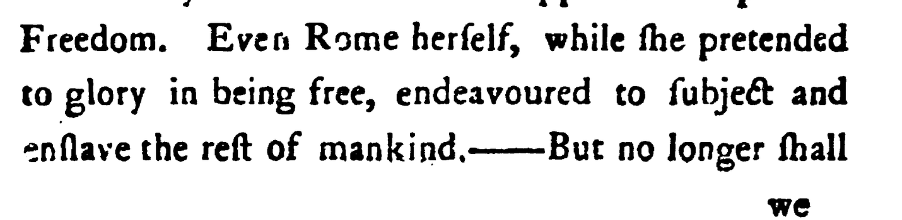
Election Sermons
Forms a Significant Distinction in Catholic and Protestant Preaching
# of Allusions/Text = 2.81
Roman Allusion Motiff

Slide 6
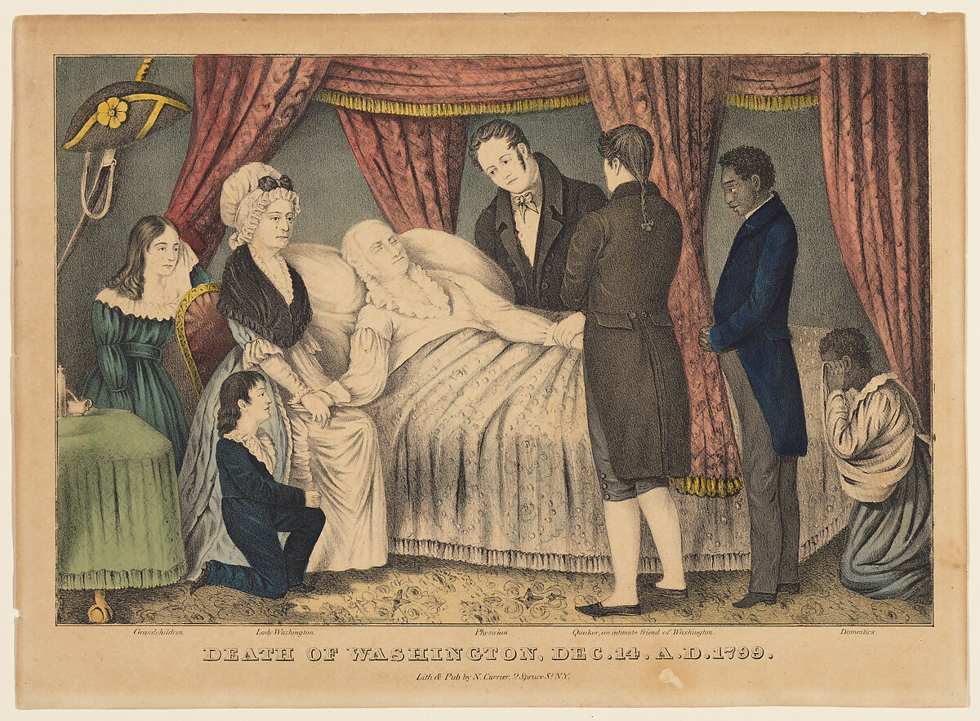
A Direct Comparison - The Death of George Washington
Bishop of Baltimore, Discourse on General Washington, February 22, 1800 by John Carroll
(12 allusions)
Vs
An eulogy on the late General George Washington February 22, 1800 by Isaac Braman, A.M
(2 allusions)

Slide 7
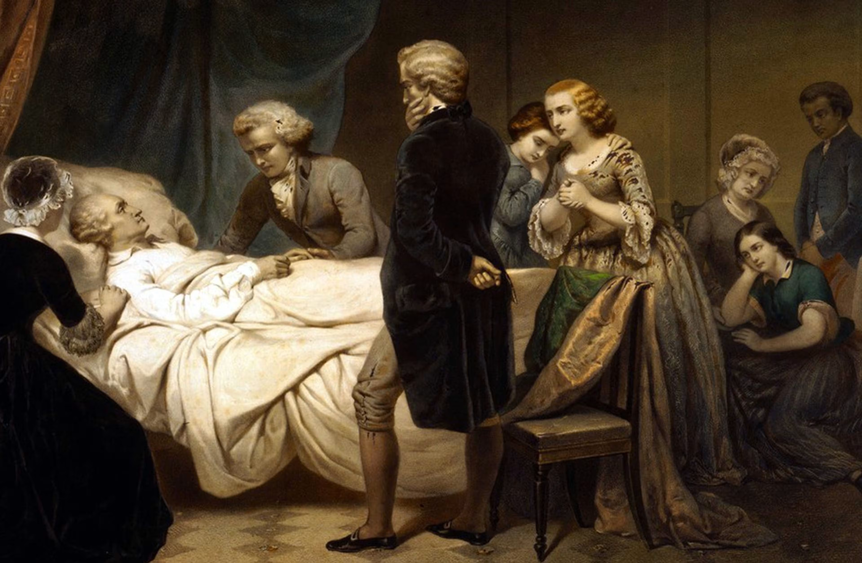
Tonality of Classical Allusions
Braman
Austerity
Biblical
American typology
Carroll
Flourish
Elegance
Sophistication
Derision (i.e Sparta, Rome)

